Slide 1
Joint Replacement Journey
Welcome to Dr. Tad Gerlinger’s
JOINT Replacement Education Class

Slide 2
Class Objectives
Understand why and how surgery is performed
Understand typical hospital course
Understand typical recovery
Discuss possible complications and how you and your surgical team can prevent possible complications

Slide 3
Knee Anatomy Overview
Femur (thighbone)
Tibia (shin bone)
Patella (knee cap)
Cartilage
a smooth tissue that cushions the ends of the bones and enables them to move easily
Ligaments
Anterior cruciate ligament (ACL)
Posterior cruciate ligament (PCL)
Medial collateral ligament (MCL)
Lateral collateral ligament (LCL)

Slide 4
Knee Anatomy (cont’d)
Arthritis
Inflammation and subsequent destruction of cartilage tissue
Types of arthritis
Osteoarthritis
Rheumatoid arthritis
Post-traumatic arthritis

Slide 5
Knee Compartments
Compartments
Medial compartment
Lateral compartment
Patellofemoral compartment
If you have arthritis in only ONE compartment, that would indicate you for a partial knee replacement or “Unicompartmental” knee replacement. If the arthritis has spread to 2 or more compartments, that would indicate you for a Total Knee Replacement.
Notes:
We find the compartments of the knee to be very important when diagnosing arthritis. If you have arthritis in only ONE compartment, that would indicate you for a Partial Knee Replacement or “Unicompartmental” knee replacement. If the arthritis has spread to 2 or more compartments, that would indicate you for a Total Knee Replacement.

Slide 6
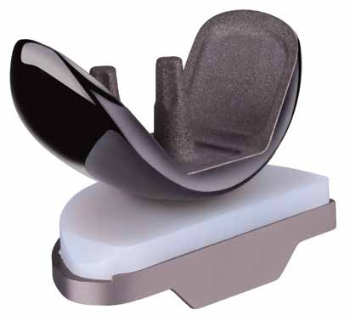
Surgical Treatment - Partial
Smith & Nephew Implant
If one compartment affected by arthritis:
Prepare the bone
Damaged surfaces removed
Position metal implants
Metal cemented to bone
Insert a spacer
Medical grade plastic separates metal surfaces to create smooth gliding surface
Notes:
Made of oxinium, titanium, and highly crosslinked polyethylene liner (plastic).

Slide 7
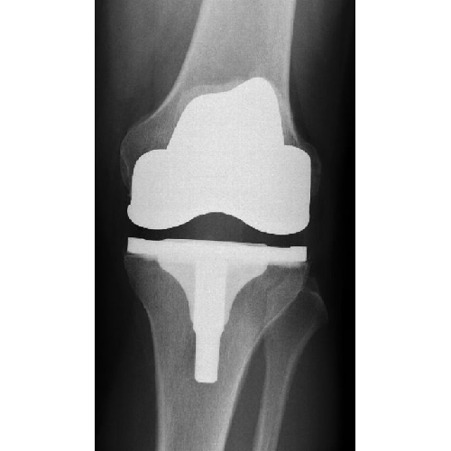
Surgical Treatment - Total
Smith & Nephew Legion Implant
If two or more compartments affected by arthritis:
Prepare the bone
Damaged surfaces removed
Position metal implants
Metal cemented to bone
Insert a spacer
Medical grade plastic separates metal surfaces to create smooth gliding surface
Resurface the patella
Plastic button applied
Notes:
Dr. Gerlinger uses a Smith and Nephew Implant named “Legion”
https://www.smith-nephew.com/key-products/orthopaedic-reconstruction/legion-total-knee-system/
Made of oxinium, titanium, a highly crosslinked polyethylene liner (plastic) and plastic button.

Slide 8
Hip Anatomy Overview
Femur (thighbone)
Pelvis
Ball and socket joint
Femoral head = ball
Acetabulum = socket
Cartilage
a smooth tissue that cushions the ends of the bones and enables them to move easily

Slide 9
Hip Anatomy (cont’d)
Arthritis
Inflammation and subsequent destruction of cartilage tissue
Types of arthritis
Osteoarthritis
Rheumatoid arthritis
Post-traumatic arthritis
Avascular necrosis
Congenital deformities

Slide 10
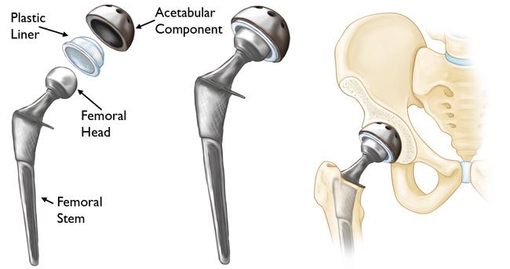
Surgical Treatment
Femoral head (ball) is removed
Metal stem inserted into hollow center of femur
Press fit vs. cemented
Ceramic ball attached to metal stem
Damaged surface of acetabulum (socket) is removed and replaced with metal cup
A screw is placed
Plastic liner
Smith & Nephew Anthology, Kyocera or Zimmer Biomet Systems
* HIP PRECAUTIONS *
For 6 weeks
1. Do not bend greater than 90 degrees
2. Do not twist your surgical leg inward
3. Do not cross your legs
Notes:
Dr. Gerlinger uses Smith & Nephew Anthology System with an R3 Cup as his implants of choice.
Made of titanium, ceramic/oxinium, and plastic liner.
** HIP PRECAUTIONS ** - Important in order to avoid dislocation and allow the bone to heal into the implant.
1. Do not bend greater than 90 degrees
2. Do not twist your surgical leg inward
3. Do not cross your legs

Slide 11
Minimally Invasive Joint Surgery
Knee: Incision smaller than traditional
3-5 inches in length vs. 8-10 inches
Hip: (Posterior Approach) Incision placed over outside of hip
4-6 inches in length
Benefits:
Less tissue disturbance
Less blood loss
Less postoperative pain
Faster rehabilitation
Notes:
Incision site varies based on the size of your bone. The incision size must be large enough for the implant to fit in. May vary by an inch or so.
Hip technique: Posterior approach

Slide 12
Incision: Closures and Dressings
Dissolvable sutures and skin glue
Aquacel AG dressing
Hydrocolloid, latex free
Designed to stay in place for 7 days
Waterproof
Anti-microbial
Dressing type #1: Aquacel
Notes:
The 1st type of closure and dressing decided by Dr. Gerlinger in surgery. Dissolvable sutures and skin glue with the Aquacel AG Bandage.
You may shower with this dressing starting 24 hours after your surgery.
No need to wrap with additional plastic wrap when showering.
No submerging in pools, hot tubs, baths until cleared by Dr. Gerlinger.
After 7 days:
Remove bandage and dispose of it. One-time use.
Site may stay open to air as long as you are keeping it clean and dry.
No topicals, lotions, salves, ointments until cleared by Dr. Gerlinger.
If you feel more comfortable with a dry dressing, we recommend using gauze and the ace bandage that was given to you in the hospital. Dr. Gerlinger discourages the use of tape because removing tape so close to the incision can lead to irritating the incision site and causing unwanted skin issues.

Slide 13
Incision: Closures and Dressings (cont’d)
Nylon sutures
Removed at 3 week f/u
Prevena Incisional Vac
Designed to stay in place for 7 days
Waterproof
Prevents infection
Promotes incision healing
Disposable (one-time use)
Dressing Type #2: Prevena
Notes:
The 2nd type of closure and dressing decided by Dr. Gerlinger in surgery. Nylon sutures with the Prevena Incisional Vac dressing.
-More commonly used on patients who are diabetic, on blood thinners, on immune suppressants, or just need additional wound healing help.
You may shower with this dressing starting 24 hours after your surgery. The bandage is waterproof. The machine is not waterproof. Recommend wrapping the machine with a plastic bag and place to the side in the shower. Or disconnecting and reconnecting.
No submerging in pools, hot tubs, baths until cleared by Dr. Gerlinger.
After 7 days:
Remove bandage and dispose of it, including the machine. One-time use and all disposable.
Site may stay open to air as long as you are keeping it clean and dry.
No topicals, lotions, salves, ointments until cleared by Dr. Gerlinger.
If you feel more comfortable with a dry dressing, we recommend using gauze and the ace bandage that was given to you in the hospital. Dr. Gerlinger discourages the use of tape because removing tape so close to the incision can lead to irritating the incision site and causing unwanted skin issues.
Nylon sutures will be removed at 3wk f/u.

Slide 14
Post Surgical Dressing Incision Care
Aquacel/Prevena is removed 7 days after surgery
Peel off like a band-aid and discard everything (including Prevena vac)
If no drainage, may leave incision open to air
If drainage, or if you prefer, cover with gauze dressing and hold in place with ACE wrap – NO TAPE
Change daily and as needed
OK to shower after surgical dressing is removed
Do not cover with saran wrap or subsequent waterproof dressing
No baths, pools, hot tubs until cleared by Dr. Gerlinger
No creams, lotions, ointments until cleared by Dr. Gerlinger

Slide 15
Anesthesia
Knee: Combination spinal/regional anesthesia with twilight sedation
Hip: Epidural with Twilight Sedation
Wake up easier with less side effects
Better pain control
Able to get up and move faster
General anesthesia if indicated by anesthesiologist
**You will meet with the anesthesia team prior to surgery
Notes:
Majority of our patients receive the twilight sedation. A few are indicated for general anesthesia, that will be decided by your anesthesia team in the preop holding area before surgery.
Twilight sedation is what you receive in a colonoscopy. It will put you to sleep. The spinal/regional and epidural blocks will completely numb you, so you feel nothing.

Slide 16
Oral Hydration for better results!
Stay well hydrated 3 days prior to surgery
Patient must finish 500mL of Gatorade 2 hours prior to scheduled arrival time to hospital.
If patient forgets to drink gatorade in time frame, surgery will not be cancelled. This is primarily to aid in your success!
Notes:
Patients can also take whatever day of surgery PO meds they are instructed to take at this time with the gatorade.
Benefits:
- decrease catabolic state during surgery (decrease detrimental effects of surgical stress)
- decrease insulin resistance (better glucose control)
- improve wound healing
- decrease surgical site swelling
- better patient satisfaction
- improved hemodynamic stability (both for spinal and surgical blood loss)
- perhaps even promote gastric emptying (less aspiration risk)

Slide 17
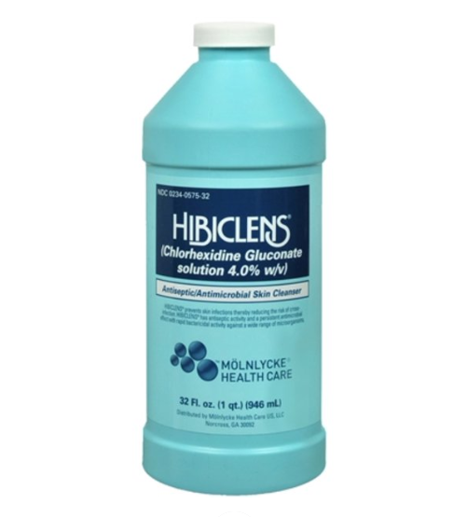
Hibiclens (before surgery)
We recommend you wash the surgical area with hibiclens the night before surgery and the AM of surgery.
Hibiclens can be purchased at any local drugstore like CVS or Walgreens.
Also called Chlorhexidine Gluconate solution
Do NOT use hibiclens on surgical
incision after surgery.

Slide 18
Hospital & Surgery Center Course
Preop Telephone Call
Perioperative Care Nurse (business day before surgery)
Given time of surgery, when to arrive, when to stop eating/drinking
Day of Surgery
Rush Medical Center (Inpatient surgery only)
Midwest Orthopaedics at Rush Oak Brook Outpatient Center
Gold Coast Surgicenter
South Suburban Surgical Suites in Indiana
Preop/Holding (1-1/2 to 2 hours before surgery)
Notes:
The perioperative care nurse will tell you the time of your surgery, what time to arrive to the hospital, when to stop eating and drinking, and making sure you are not taking any medications on your do not take list.
Family is welcome in the preop holding area with you. This is where you will be prepped for surgery and meet with your surgical and anesthesia teams.
Rush University Medical Center: 1653 W Congress Pkwy, Chicago, IL 60612
Midwest Orthopaedics at Rush Oak Brook: 2011 York Road, Oak Brook, IL 60154
Gold Coast Surgicenter: 845 N Michigan Ave #985w, Chicago, IL 60611
South Suburban Surgical Suites: 9200 Calumet Ave Ste E-100, Munster, Indiana 46321

Slide 19
Hospital Course (cont’d)
Operating Room (1-1/2 to 2 hours)
Positioning
Surgical Procedure (30 to 45 minutes)
Incision Closure
Reverse Anesthesia
Recovery Room (1 to 2 hours)
Last stop for outpatient surgery
Orthopedic Floor / 13 East Tower (1-2 days)

Slide 20
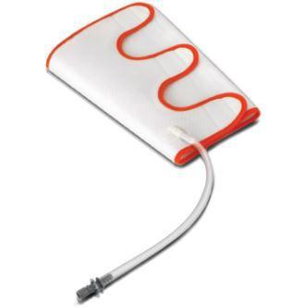
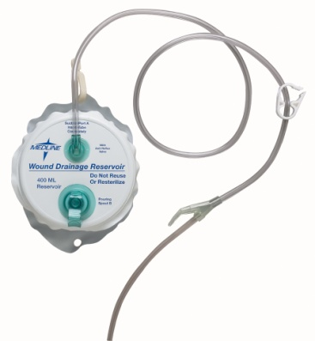
Lines, Tubes, Drains
Peripheral IV
Removed at discharge
Sequential Compression Device
Decrease risk of blood clots
Hemovac
Helps decrease pressure on incision
Total Knee Replacements only
Notes:
Hemovac drain only for Total Knee Replacements. Removed before discharge.

Slide 21
Discharge Requirements
Physical Therapy
Stair climbing, gait training, use of ambulatory device
Will issue ambulatory device (cane, crutches, walker) at discharge
Medically Stable
Labs and vital signs must be within normal limits prior to discharge
Pain Management
Medication scripts sent to pharmacy at discharge
Notes:
Inpatient and outpatient surgical patients will meet with Physical therapy before discharge. They will assist in sizing you for your assistive device. They will walk around the unit with you, do stairs, and teach you our home exercise program consisting of some light stretches and exercises Dr. Gerlinger would like for you to practice once you get home. He recommends you do these exercises for the week following your surgery, and then go straight to outpatient physical therapy one week after your surgery.
We will make sure you labs and vital signs are within normal limits and your pain is well controlled before discharge.

Slide 22
Cold Therapy after Surgery
Cold Therapy for your Comfort
To help ease your pain and swelling after surgery, you will be given a cold therapy wrap with 2 gel ice packs
Each gel pack will remain cold for up to 4 hours
Ice at least 4-5 times a day for 20 minutes at a time
Ice machines can be purchased through our DME store
Notes:
You will receive gel ice packs after your surgery. Ice as much as you can tolerate. Always remember to put a barrier in between the ice and your skin to avoid frostbite.
Dr. Gerlinger does not require the use of cooling units post operative. Most insurance companies do not cover the cooling units and they are pricey. Research shows that those cooling units don’t do much more than a frozen bag of peas. We know the gel ice packs work and is covered under insurance so that is why we provide these for you.
If interested, you may purchase a cooling unit online or at our DME store.

Slide 23
Typical Postoperative Pain Management
Drug | Use | Dose/Frequency | Quantity | Duration
Gabapentin | Neuropathic/Nerve pain | 200mg/ three times a day (6am, 2pm, 10pm) | 90 | 14 days – no refills
Tylenol* | Pain management | 1000mg / three times a day (6am, 2pm, 10pm) | 90 | 5-7 days scheduled
Tramadol* | Pain management | 100mg / three times a day (6am, 2pm, 10pm) | 42 | 5-7 days scheduled
Meloxicam | Anti-inflammatory | 15mg / once a day | 30 | 30 days – no refills
Oxycodone** | Pain management | 5mg / every 4-6 hours as needed | 30 | As needed
*Please contact office for refills – No refills provided after 6 weeks postop
**No refills provided after 3 weeks postop
Notes:
This postoperative pain management regimen was created in collaboration by the pain anesthesiologists in the hospital and our orthopedic joint surgeons here at MOR. They created a multi-modal schedule. Multi-modal meaning “acting on different pain pathways.” Schedule meaning “taking around the clock with or without pain.” The whole goal is to stay ahead of the pain, rather than trying to play catch up since we know that is a hard game to play. We are very conservative here at MOR and give low doses, least amount, so you never feel like you will get addicted to these narcotics. Our goal is to cover you pain appropriately and safely, which is what we intend to do.

Slide 24
Other Medications
Aspirin 81mg twice a day
Blood clot prevention
May vary depending on medical history
Senna-S 8.6/50mg twice a day
Stool softener
**Cefadroxil 500mg twice a day
Oral antibiotic
**Ondansetron 4mg as needed
Nausea
**Outpatient surgery only
Notes:
Complete full course of blood thinner*

Slide 25
Physical Therapy
Outpatient Physical Therapy in the Home (OPITH)
MOR will send a therapist to your home after surgery
2-3 x/week starting 5-10 days after your surgery
You will be contacted 2 weeks prior to schedule these in home visits
Your therapist will transition you to an outpatient clinic by week 3. Dr Gerlinger recommends one of our MOR PT locations (map on our website)
The 1st week: Practice home exercises/stretches taught by the therapist in the hospital
Patients may opt out of the OPITH program and start outpatient PT starting 5-10 days post op
Notes:
Some outpatient physical therapy locations offer transportation (look into ATI or Athletico).
Dr. Gerlinger feels strongly about doing your home exercises/stretches (taught by the therapist in the hospital post operative) for the first week after your surgery while getting a jump start on the healing process. Start outpatient physical therapy one week after your surgery.

Slide 26
Follow Up Office Visits
3 weeks postop
Wound check
X-rays
Nylon sutures removed (if applicable)
6 weeks postop
X-rays
Annual and as needed
Telemedicine visit available upon request
Notes:
Nylon sutures removed at 3wk postop f/u.
Six week minimum between surgeries.

Slide 27
Visits with our Nurse Practioner, Alissa Winner
Midwest Orthopaedic Locations
Postop follow up appointments
Hip or Knee Evaluations
Knee Injections
To schedule, please contact Dr. Gerlinger’s office!
Telemedicine available upon request

Slide 28
When Can I…
Return to work?
Light duty/desk job: 2-4 weeks postop
Heavy duty/Labor intensive: 6-8 weeks postop
Drive?
2 weeks post op research shows your brake reflex is back
Must be off pain medications and feel safe
Fly?
Preferably after 3 week wound check appointment
No implant cards anymore- opt to go through scanner at TSA
Return to activities/exercise?
Typically by 6 weeks 75% recovered, 6 months 100%
Ease into activity after 6 weeks
Have my other knee/hip replaced?
Six weeks between surgeries minimum
Notes:
Work: If you provide our office with FMLA paperwork, we will write you off for 12 weeks and then write a return to work letter if ready to go back before then.
Drive: Dr. Gerlinger has done studies that show your brake reflex comes back about 2 weeks after your surgery. If you are 2 weeks post op and off the tramadol and oxycodone (your narcotics) and feel safe getting behind the wheel, you may do so. If you happened to get in an accident and the person you had an accident with finds out you are not 6 weeks post operative, they can take legal action.
Fly: You now have metal in your joint, you will set off alarms at TSA. TSA does not have cards anymore. All you have to do is let your TSA agent know you have a metal implant and opt to go through the scanner where you put you arms above your head. You should have no issues with setting off alarms using this method.
Exercise: We expect you to reach 75% healed at about 6 weeks and reach 100% at 6 months to a year. Returning to normal activity starts around the 6 week mark.
Other side surgery: You cannot get both knees/hips operated on the same time. 6 week minimum between surgeries.

Slide 29
Potential Risks and Complications
Infection
Medically optimized by a RUSH Internist
Hibiclens (wash surgical area night before and AM of surgery)
Intravenous antibiotics given in hospital
Private rooms
Short hospital stay
Dental prophylaxis
Lifelong recommendation for any and all dental procedures
Amoxicillin 2000 mg 1 hour before
Clindamycin 600 mg 1 hour before (if allergic to penicillin)
No dental work 3wks prior to surgery and 3months after surgery
Deep Vein Thrombosis / Pulmonary Embolism
Anticoagulation medication
Early mobilization
Hematoma
Hemovac
Surgical compression dressing
Notes:
Wash your surgical site with hibiclens the night before your surgery and the morning of. There is a sheet in your surgical folder explaining in more depth.
Dentist prophylaxis: Our mouths are full of bacteria and when you go to the dentist, they poke around creating entryways for bacteria to enter the blood stream and they can colonize on new implants. Dr. Gerlinger has a lifelong recommendation of taking an oral antibiotic 1 hr before any dental cleaning, tooth extraction, cavity refill, etc. He also recommends NO elective dental work 3 weeks before your surgery and 3 months after your surgery to avoid infection.

Slide 30
Potential Risks and Complications (cont’d)
Loosening / Failure of Implant
Low impact exercises
Residual Pain/Stiffness
Fracture
Nerve Injury
Elevated risk for peroneal nerve injury with preoperative valgus (knock knee) deformity
Blood Loss
Skin tears, blisters, delayed wound healing
“Clicking”
Leg Length Discrepancy
Insomnia

Slide 31
Symptoms After Surgery
Common
When to Call
Swelling throughout leg
Bruising throughout leg
Warmth
Incision redness
Low grade temperatures (< 101.5)
** always feel free to call to discuss
Calf pain, swelling, redness
Fevers greater than 101.5
Significant drainage
Pain uncontrolled with medications
Spreading redness

Slide 32
Sign up for Dr. Gerlinger’s surgery texts
Before surgery, text “JOIN” to 312-340-0700
Follow prompts to enroll
Standard messaging & data rates apply
See Terms and Conditions: www.mystreamd.com/terms
Notes:
Green card in surgical folder. Reminders and encouraging tips in text form.

Slide 33
Optional Nutrition Package Available for Purchase
EMN Orthopedic Nutrition Bundle
Supports lean muscle mass and wound healing
Designed for 2 wks before surgery and 2 wks after surgery
Flavors: Vanilla Bean and Decaf Cold Brew
To purchase:
Please visit one of MOR DME stores or:
Emnortho.com
Code: gerlinger
Notes:
Flyer in surgical folder with more information. Available for purchase on https://emnortho.com/ or at our DME store!

Slide 34
What do I do now? How to prepare for your surgery
Stop medications as directed by your RUSH Internist
Prepare living arrangements as necessary
Sign up for surgical texts
Start protein supplement (optional)
Wash surgical area with Hibiclens
Stay well hydrated and eat nutritious meals
Relax and know you that you are in good hands!

Slide 35
Thank You
Please reach out with any questions!
Kelly Murray, RN
Alissa Winner, DNP
Gerlinger Office
312-432-2429

