Slide 1

Joint Replacement Journey
Dr. Tad Gerlinger’s
JOINT Replacement Education POWERPOINT

Slide 2

Sign up for Dr. Gerlinger's surgery text messages
We strongly encourage patients to sign up for Dr. Gerlinger’s surgery text messages prior to surgery
  Text “JOIN” to 312-340-0700 then follow prompts to enroll. You can enroll at any point even after surgery. You will begin receiving messages two weeks prior to surgery (if you enroll prior) and for approximately six weeks after surgery.
    Standard messaging & data rates apply
    See Terms and Conditions: www.mystreamd.com/terms
Notes:
Green card in surgical folder. Reminders and encouraging tips in text form.

Slide 3
PowerPoint Objectives
Understand why and how surgery is performed
Understand typical course (pre and post surgery)
Understand typical recovery
Discuss possible complications and how you and your surgical team can prevent possible complications

Slide 4
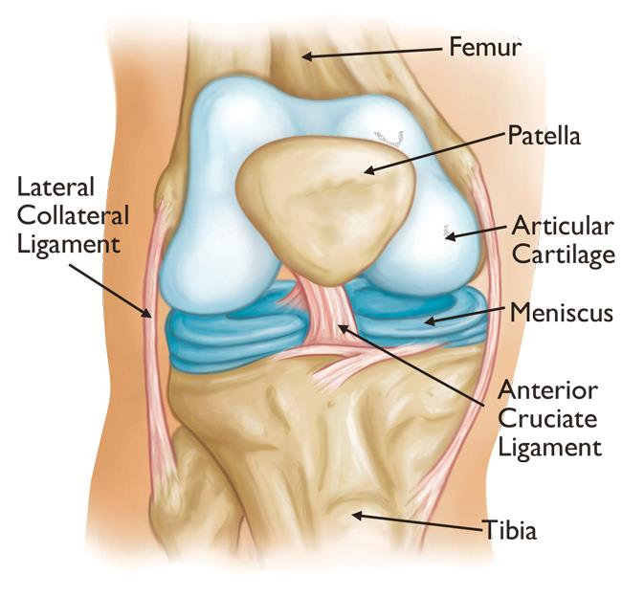
Knee Anatomy Overview
Femur (thighbone)
Tibia (shin bone)
Patella (knee cap)
Cartilage
  a smooth tissue that cushions the ends of the bones and enables them to move easily
Ligaments
  Anterior cruciate ligament (ACL)
  Posterior cruciate ligament (PCL)
  Medial collateral ligament (MCL)
  Lateral collateral ligament (LCL)

Slide 5
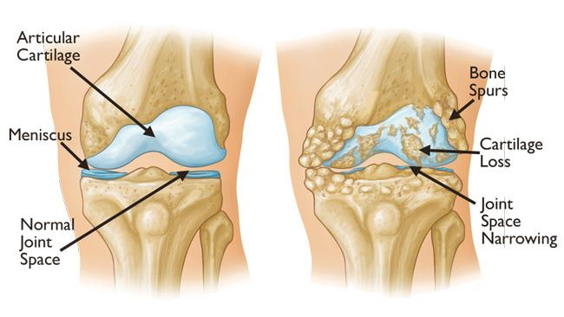
Knee Anatomy (cont’d)
Arthritis
  Inflammation and subsequent destruction of cartilage tissue
Several types of arthritis
  Osteoarthritis
  Rheumatoid arthritis
  Post-traumatic arthritis

Slide 6
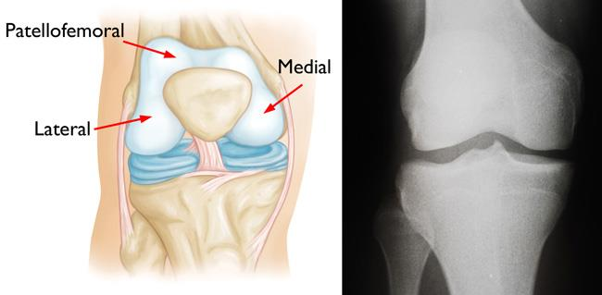
Knee Compartments
Compartments
  Medial compartment
  Lateral compartment
  Patellofemoral compartment
If you have arthritis in only ONE compartment, that would indicate you for a partial knee replacement or “Unicompartmental” knee replacement. If the arthritis has spread to 2 or more compartments, that would indicate you for a Total Knee Replacement.
Notes:
We find the compartments of the knee to be very important when diagnosing arthritis. If you have arthritis in only ONE compartment, that would indicate you for a Partial Knee Replacement or “Unicompartmental” knee replacement. If the arthritis has spread to 2 or more compartments, that would indicate you for a Total Knee Replacement.

Slide 7
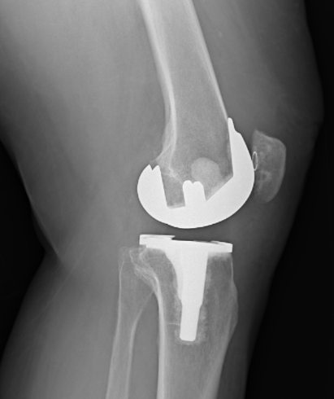
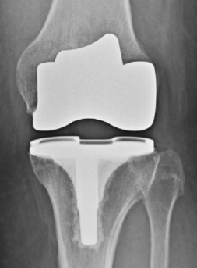
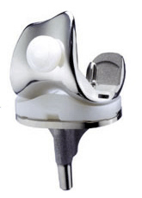
Surgical Treatment - Total
Smith & Nephew - Legion System
If two or more compartments affected by arthritis:
  Prepare the bone
    Damaged surfaces removed
  Position metal implants
    Metal cemented to bone
  Insert a spacer
    Medical grade plastic separates metal surfaces to create smooth gliding surface
  Resurface the patella
    Plastic button applied
Notes:
Dr. Gerlinger uses a Smith and Nephew Implant named “Legion”
https://www.smith-nephew.com/key-products/orthopaedic-reconstruction/legion-total-knee-system/
Made of oxinium, titanium, a highly crosslinked polyethylene liner (plastic) and plastic button.

Slide 8
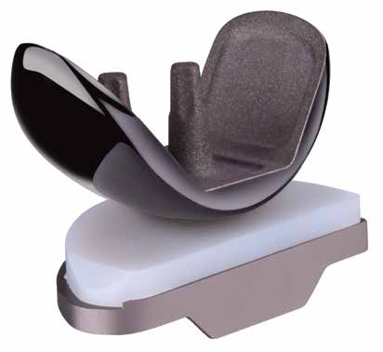
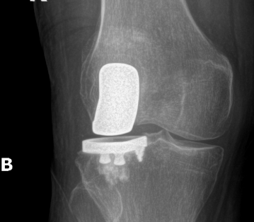
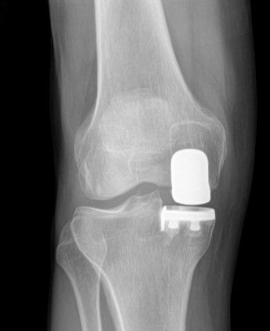
Surgical Treatment - Partial
Smith & Nephew: Journey II Uni System
One compartment (medial or lateral) affected by arthritis:
  Prepare the bone
    Damaged surfaces removed
  Position metal implants
    Metal cemented to bone
  Insert a spacer
    Highly-crosslinked plastic separates metal surfaces to create smooth gliding surface
Lateral (outside of knee) partial knee replacement
Medial (inside of knee) partial knee replacement
Notes:
Made of oxinium, titanium, and highly crosslinked polyethylene liner (plastic).

Slide 9
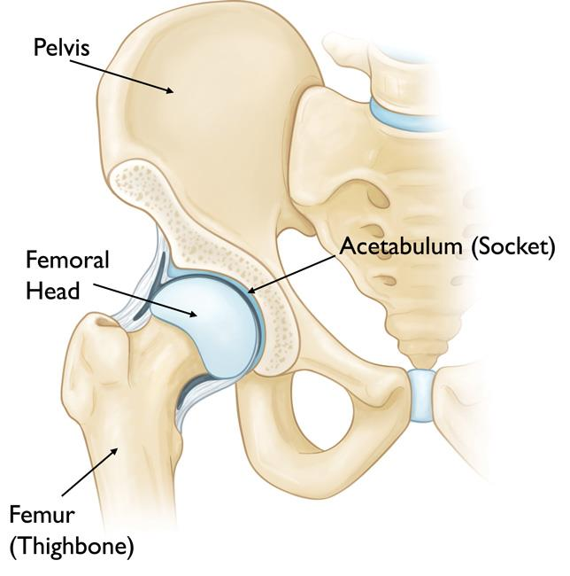
Hip Anatomy Overview
Femur (thighbone)
Pelvis
Ball and socket joint
  Femoral head = ball
  Acetabulum = socket
Cartilage
  a smooth tissue that cushions the ends of the bones and enables them to move easily

Slide 10
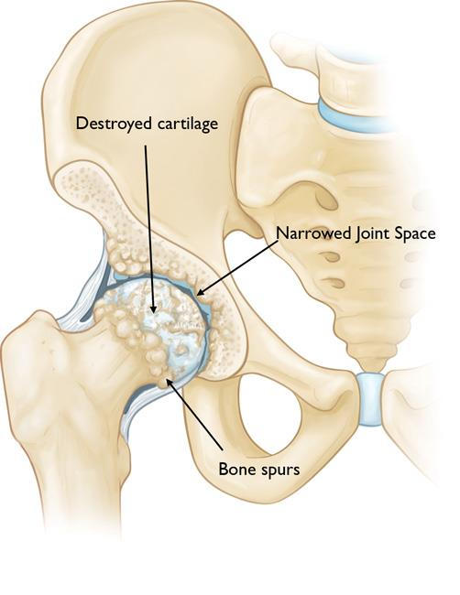
Hip Anatomy (cont’d)
Arthritis
  Inflammation and subsequent destruction of cartilage tissue
Types of arthritis
  Osteoarthritis
  Rheumatoid arthritis
  Post-traumatic arthritis
  Avascular necrosis
  Congenital deformities

Slide 11
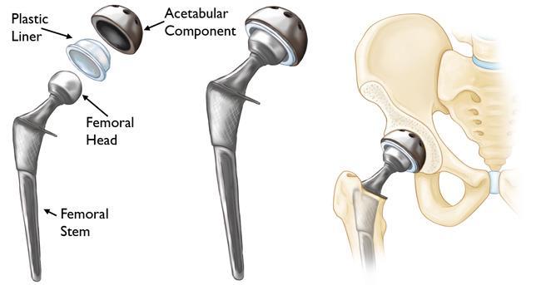
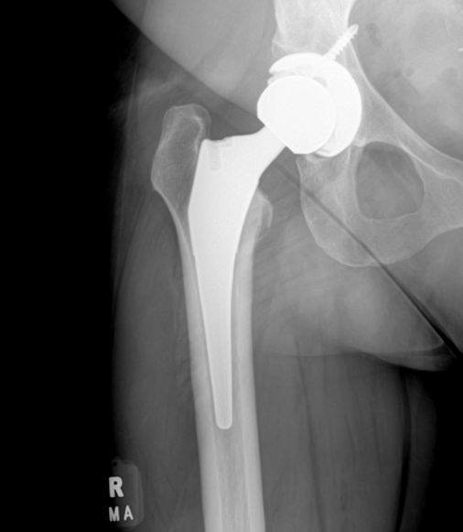
Surgical Treatment
Femoral head (ball) is removed
Metal stem inserted into hollow center of femur
  Press fit vs. cemented
Ceramic or oxinium ball attached to metal stem
Damaged surface of acetabulum (socket) is removed and replaced with metal cup
  A screw is placed
Plastic liner
Type: Smith & Nephew Anthology, Kyocera or Zimmer Biomet Systems
* HIP PRECAUTIONS FOR 6 WEEKS *
1. Do not bend greater than 90 degrees
2. Do not twist your surgical leg inward
3. Do not cross your legs
Notes:
Dr. Gerlinger uses Smith & Nephew Anthology System with an R3 Cup as his implants of choice.
Made of titanium, ceramic/oxinium, and plastic liner.
** HIP PRECAUTIONS ** - Important in order to avoid dislocation and allow the bone to heal into the implant.
1. Do not bend greater than 90 degrees
2. Do not twist your surgical leg inward
3. Do not cross your legs

Slide 12
SURGERY LOCATIONS
Outpatient Surgery Centers:
Rush Oak Brook Surgery Center
Gold Coast Surgery Center
South Suburban Surgical Suites
Hospital:
Rush University Medical Center

Slide 13
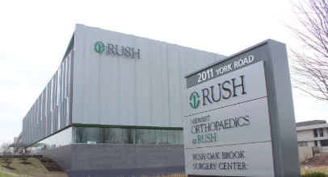
Rush Oak Brook Surgery Center
Oak Brook, IL - Rush Oak Brook Surgery Center
2011 York Rd, Oak Brook, IL 60523
Third floor
Facility phone #: 630-472-2445

Slide 14
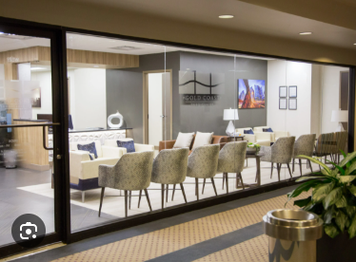
Gold Coast Surgery Center
Chicago, IL - Gold Coast Surgery Center
845 N Michigan Ave #985W, Chicago, IL 60611
located in back of Water Tower Place on 9th floor
Facility phone #: (312) 521-5500

Slide 15
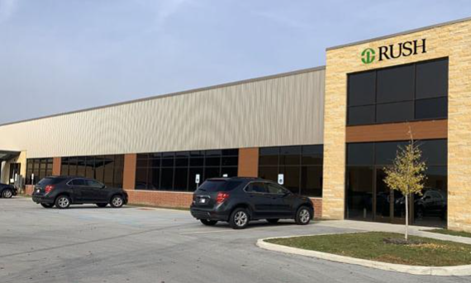
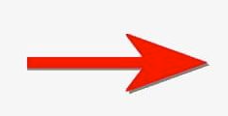
South Suburban Surgial Suites
Munster, IN - South Suburban Surgical Suites
9200 Calumet Ave Suite E100 Munster, Indiana, 46321
Located next to Rush medical building
Facility phone #: (219) 595-0601
Facility entrance

Slide 16
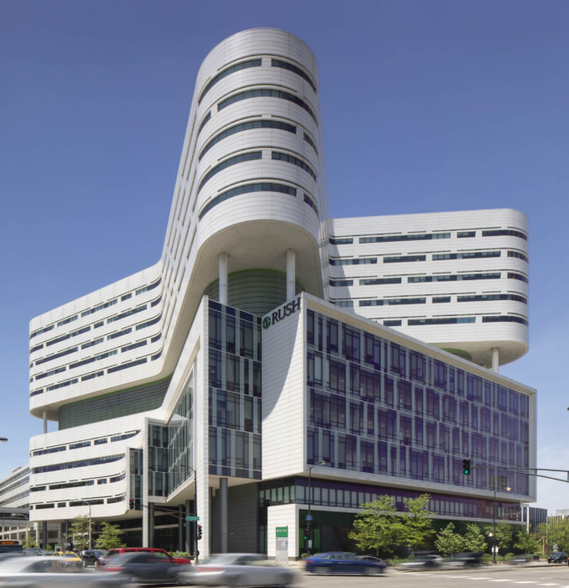

Rush University Medical Center
Rush University Medical Center
1620 W. Harrison St., Chicago, IL 60612
Surgery takes place on 7th floor in the tower building
Patients having surgery at RUMC stay overnight
  Generally speaking, hospital surgery patients stay one night overnight
Surgery takes place here

Slide 17
PREOPERATIVE INFO

Slide 18
Sign up for Dr. Gerlinger's surgery text messages
We strongly encourage patients to sign up for Dr. Gerlinger’s surgery text messages prior to surgery
  Text “JOIN” to 312-340-0700 then follow prompts to enroll. You can enroll at any point even after surgery. You will begin receiving messages two weeks prior to surgery (if you enroll prior) and for approximately six weeks after surgery.
    Standard messaging & data rates apply
    See Terms and Conditions: www.mystreamd.com/terms
Notes:
Green card in surgical folder. Reminders and encouraging tips in text form.

Slide 19
Rush Medical Optimization Prior to Surgery
All patients will see a Rush Internist within 30 days of surgery date
  Kelly will schedule this appointment for you
  Prefer appointment to be earlier in the 30-day window
Depending on your specific history, you may be required to see a Rush specialist (ex: cardiologist, hematologist)
  Kelly will schedule this appointment for you
Notes:
The perioperative care nurse will tell you the time of your surgery, what time to arrive to the hospital, when to stop eating and drinking, and making sure you are not taking any medications on your do not take list.
Family is welcome in the preop holding area with you. This is where you will be prepped for surgery and meet with your surgical and anesthesia teams.
Rush University Medical Center: 1653 W Congress Pkwy, Chicago, IL 60612
Midwest Orthopaedics at Rush Oak Brook: 2011 York Road, Oak Brook, IL 60154
Gold Coast Surgicenter: 845 N Michigan Ave #985w, Chicago, IL 60611
South Suburban Surgical Suites: 9200 Calumet Ave Ste E-100, Munster, Indiana 46321

Slide 20
Preoperative Calls
Kelly will contact you with your Rush preoperative medical appointment and any necessary specialist appointments
Midwest Ortho DME store will call you to discuss ice and nutrition options available for purchase
  Please note you will be issued a walker or crutches from your surgery facility
Midwest Ortho Physical Therapy will call you to discuss postoperative PT and determine your location for service
Alissa will call you prior to surgery to check-in. Post-op medications will be sent to your pharmacy about one week prior to surgery
Surgery facility will call you one business day prior to surgery to give you surgery time and instructions for day of surgery
  You will be contacted on Friday for a Monday surgery
Notes:
The perioperative care nurse will tell you the time of your surgery, what time to arrive to the hospital, when to stop eating and drinking, and making sure you are not taking any medications on your do not take list.
Family is welcome in the preop holding area with you. This is where you will be prepped for surgery and meet with your surgical and anesthesia teams.
Rush University Medical Center: 1653 W Congress Pkwy, Chicago, IL 60612
Midwest Orthopaedics at Rush Oak Brook: 2011 York Road, Oak Brook, IL 60154
Gold Coast Surgicenter: 845 N Michigan Ave #985w, Chicago, IL 60611
South Suburban Surgical Suites: 9200 Calumet Ave Ste E-100, Munster, Indiana 46321

Slide 21
Chlorhexidine Gluconate (CHG) aka Sage, Hibiclens (soap before surgery)
We recommend you wash the surgical site with CHG the night before surgery and the morning of surgery
CHG can be purchased at any local drugstore like CVS or Walgreens. The DME store at our practice sells this product as well
Do not wash incision/skin with CHG after surgery. You will use usual antibacterial soap (ex: Dial) on skin after surgery

Slide 22
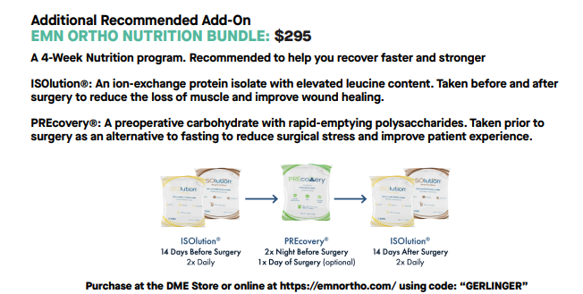
Optional Nutrition Package Available for Purchase
EMN Orthopedic Nutrition Bundle
Supports lean muscle mass and wound healing
Designed for 2 wks before surgery and 2 wks after surgery
Sold at Midwest Ortho DME store
  Call (708) 492-5759 with any questions
Notes:
Flyer in surgical folder with more information. Available for purchase on https://emnortho.com/ or at our DME store!

Slide 23
Cold Therapy (Ice) after Surgery
You will want to apply ice to surgical site at least 4-5 times per day for at least 3o minutes to one hour which helps ease pain and swelling after surgery
Cold therapy can be purchased through our DME store
    Please contact the DME store with any questions regarding ice options at (708) 492-5759. The DME store will generally call you one week prior to surgery to discuss options in addition to the nutrition package
Notes:
You will receive gel ice packs after your surgery. Ice as much as you can tolerate. Always remember to put a barrier in between the ice and your skin to avoid frostbite.
Dr. Gerlinger does not require the use of cooling units post operative. Most insurance companies do not cover the cooling units and they are pricey. Research shows that those cooling units don’t do much more than a frozen bag of peas. We know the gel ice packs work and is covered under insurance so that is why we provide these for you.
If interested, you may purchase a cooling unit online or at our DME store.

Slide 24
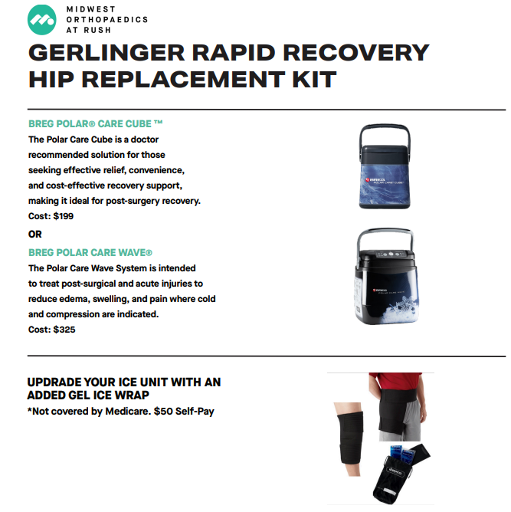
Cold Therapy (Ice) for Hip Replacement Patients

Slide 25
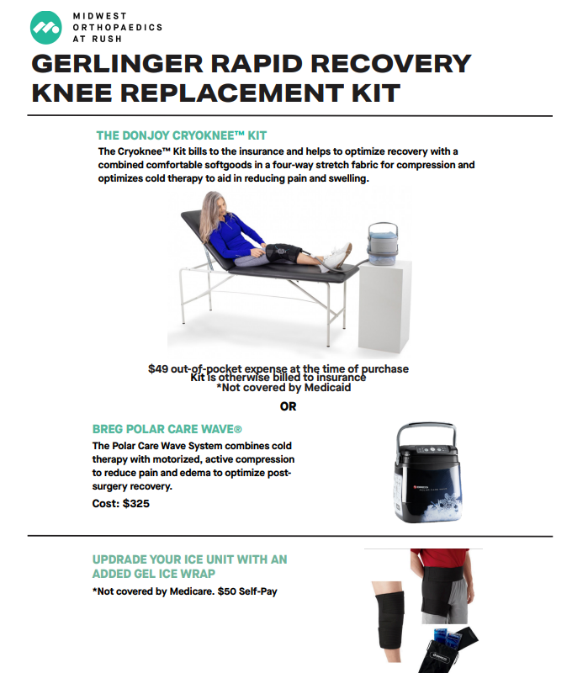
Cold Therapy (Ice) for Knee Replacement Patients

Slide 26
Pre-Op Hydration for better results
Stay well hydrated 3 days prior to surgery
Recommend patients drink 500mL of Gatorade 2 hours prior to scheduled arrival time to facility
  (example: arrival time 8am – finish Gatorate by 6am)
  If you do not like Gatorade or forget to drink Gatorade then disregard and do not eat/drink anything else/substitute
  If patient forgets to drink Gatorade in time frame, surgery will not be cancelled. This is primarily to aid in your success!
Notes:
Patients can also take whatever day of surgery PO meds they are instructed to take at this time with the gatorade.
Benefits:
- decrease catabolic state during surgery (decrease detrimental effects of surgical stress)
- decrease insulin resistance (better glucose control)
- improve wound healing
- decrease surgical site swelling
- better patient satisfaction
- improved hemodynamic stability (both for spinal and surgical blood loss)
- perhaps even promote gastric emptying (less aspiration risk)

Slide 27
Medications to Stop Prior to Surgery
Stop one week prior:
GLP-1 medications (ex: Mounjaro, Ozempic, Wegovy, Trulicity)
Aspirin (unless your cardiologist recommends you continue taking without stopping)
NSAIDs (Motrin, Advil, Aleve, Meloxicam, Diclofenac)
Relafen (Nabumetone)
Vitamins/supplements
  OK to continue taking Vitamin D, Calcium, and Iron
Herbal supplements
Eliquis and Xarelto are generally held 72 hours prior to surgery but you should be given a specific stop date by the Rush internist and/or hematologist and/or cardiologist
For any questions regarding your routine medications, please contact the Rush medical provider you saw prior to surgery and/or Rush specialist
The Rush medical provider should instruct you which medications you should take the morning of your surgery based on your specific medication list

Slide 28
SURGERY INFO

Slide 29
Surgery Center Course
Operating Room (~1-1/2 hours for primary surgery)
  Positioning/Anesthesia
  Surgical Procedure (~45 minutes)
  Incision Closure
Recovery Room (~2-3 hours)
  PT will meet with you in recovery room and issue you walker or crutches
    You will do stairs with PT prior to discharge
  You will eat/drink in the recovery room
  You will urinate prior to discharge
  We will ensure pain is well-managed prior to discharge
  Discharge teaching by PACU nurse

Slide 30
Hospital Course
Operating Room (~1-1/2 hours for primary surgery)
  Positioning/Anesthesia
  Surgical Procedure (~45 minutes)
  Incision Closure
Recovery Room (~2 hours)
Orthopedic Floor / 13 East Tower (generally one night)
    PT will see you the day after surgery and nurse will get you up walking the day of surgery
      You will pass PT prior to discharge
    Discharge medications will be sent to pharmacy by inpatient orthopedic team and they will verify your pharmacy while inpatient
    Medical team will see you while inpatient to co-manage any medical issues you may have

Slide 31
Minimally Invasive Joint Surgery
Knee: Incision near center of knee
  3-5 inches in length
Hip: (mini-posterior approach) Incision on side of hip
  4-6 inches in length
Benefits:
  Less tissue disturbance
  Minimal blood loss
  Regional anesthesia / improved pain management pathway that minimizes narcotics
  Improved perioperative pathway /process
  Walking day of surgery
  Smaller incisions
    Incision size may vary based on patient-specific factors, prior surgery, implant sizes, etc.
Notes:
Incision site varies based on the size of your bone. The incision size must be large enough for the implant to fit in. May vary by an inch or so.
Hip technique: Posterior approach

Slide 32
Anesthesia
Knee: Spinal anesthesia with twilight sedation (knee replacement patients will get an adductor canal block in pre-op area which helps with post-op pain management)
Hip: Spinal with twilight sedation
General anesthesia if indicated by anesthesiologist and/or dictated by your medical history
**You will meet with the anesthesia team on the morning of surgery prior to surgery**
Notes:
Majority of our patients receive the twilight sedation. A few are indicated for general anesthesia, that will be decided by your anesthesia team in the preop holding area before surgery.
Twilight sedation is what you receive in a colonoscopy. It will put you to sleep. The spinal/regional and epidural blocks will completely numb you, so you feel nothing.

Slide 33
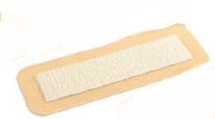
Incision: Closures and Dressings
Dissolvable sutures beneath skin with skin glue
WITH:
Aquacel AG dressing
  Hydrocolloid, latex free
  Designed to stay in place for 7 days
  Waterproof
  Anti-microbial
Dressing type #1: Aquacel
Notes:
The 1st type of closure and dressing decided by Dr. Gerlinger in surgery. Dissolvable sutures and skin glue with the Aquacel AG Bandage.
You may shower with this dressing starting 24 hours after your surgery.
No need to wrap with additional plastic wrap when showering.
No submerging in pools, hot tubs, baths until cleared by Dr. Gerlinger.
After 7 days:
Remove bandage and dispose of it. One-time use.
Site may stay open to air as long as you are keeping it clean and dry.
No topicals, lotions, salves, ointments until cleared by Dr. Gerlinger.
If you feel more comfortable with a dry dressing, we recommend using gauze and the ace bandage that was given to you in the hospital. Dr. Gerlinger discourages the use of tape because removing tape so close to the incision can lead to irritating the incision site and causing unwanted skin issues.

Slide 34
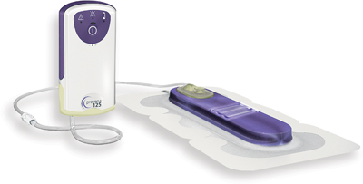
Incision: Closures and Dressings (cont’d)
Nylon sutures
  Removed at 3 week follow up appointment
  Used for revision surgery incisions/patients with added risk factors
Negative Pressure Incisional Vac (Prevena)
  Designed to stay in place for 7 days then peel off and throw everything away
  Turn away from water
  Helps prevent infection
  Promotes incision healing
Dressing Type #2: Prevena
Notes:
The 2nd type of closure and dressing decided by Dr. Gerlinger in surgery. Nylon sutures with the Prevena Incisional Vac dressing.
-More commonly used on patients who are diabetic, on blood thinners, on immune suppressants, or just need additional wound healing help.
You may shower with this dressing starting 24 hours after your surgery. The bandage is waterproof. The machine is not waterproof. Recommend wrapping the machine with a plastic bag and place to the side in the shower. Or disconnecting and reconnecting.
No submerging in pools, hot tubs, baths until cleared by Dr. Gerlinger.
After 7 days:
Remove bandage and dispose of it, including the machine. One-time use and all disposable.
Site may stay open to air as long as you are keeping it clean and dry.
No topicals, lotions, salves, ointments until cleared by Dr. Gerlinger.
If you feel more comfortable with a dry dressing, we recommend using gauze and the ace bandage that was given to you in the hospital. Dr. Gerlinger discourages the use of tape because removing tape so close to the incision can lead to irritating the incision site and causing unwanted skin issues.
Nylon sutures will be removed at 3wk f/u.

Slide 35
Post Surgical Dressing Incision Care
Aquacel OR Prevena Vac: Remove at home 7 days from surgery
  Peel off like a band-aid and discard everything (including Prevena vac)
  If no drainage, may leave incision open to air and can wrap knee with ACE wrap for compression (avoid tape)
    Call office if drainage at any point
  Change daily and as needed
OK to shower after surgical dressing is removed
  Do not cover with saran wrap or subsequent waterproof dressing
  No baths, pools, hot tubs until incision healed and there are no scabs
  No creams/lotions until 3-week office visit incision check

Slide 36
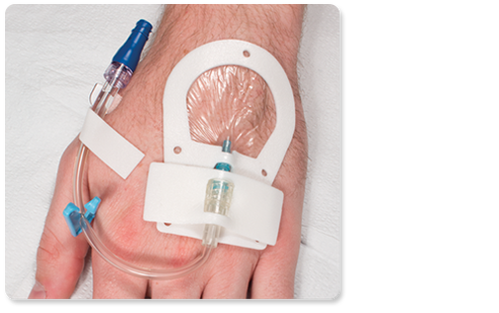
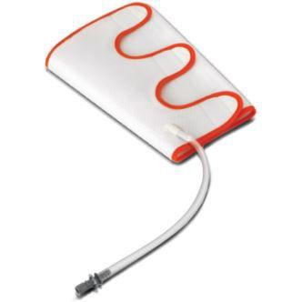
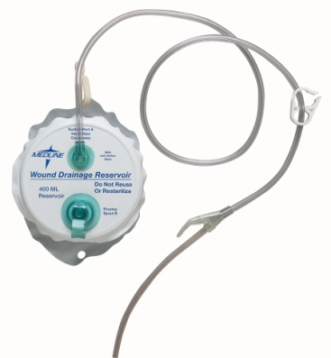
Lines, Tubes, Drains
Peripheral IV
  Removed at discharge
Sequential Compression Device
  Decrease risk of blood clots
Drain for total knee replacement
  Helps decrease pressure on incision
  Removed day of surgery for outpatient cases and day after surgery for hospital cases
Notes:
Hemovac drain only for Total Knee Replacements. Removed before discharge.

Slide 37
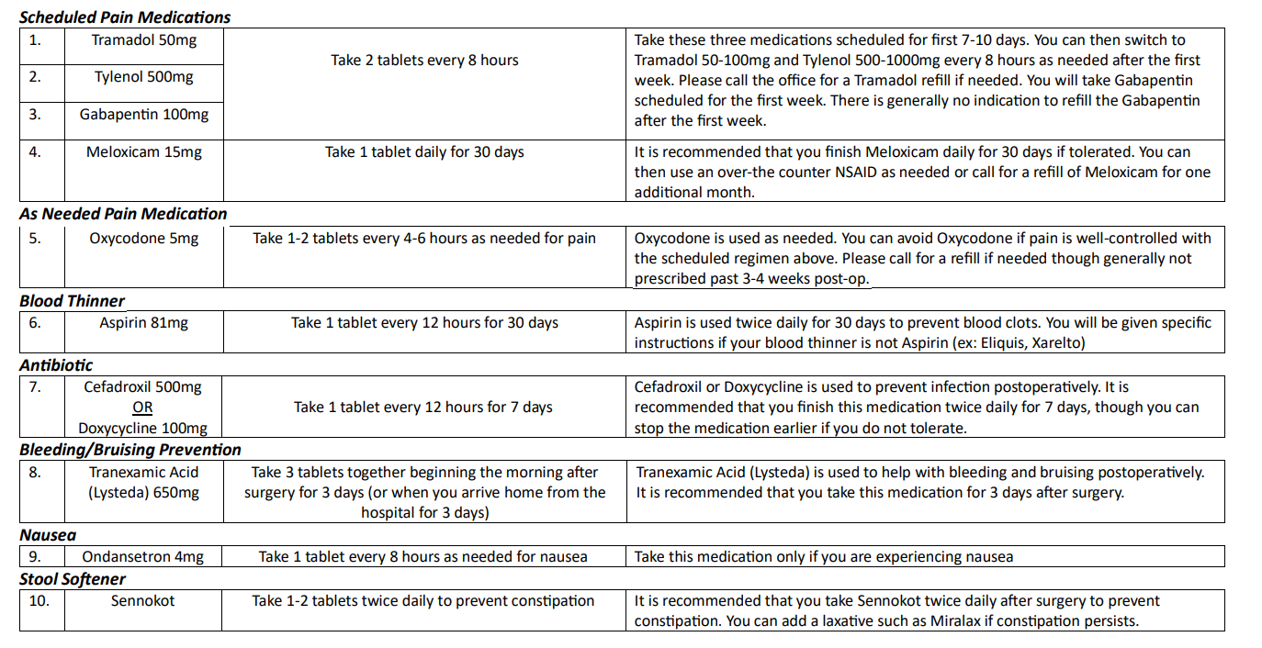
Typical Post-op Medication Regimen

Slide 38
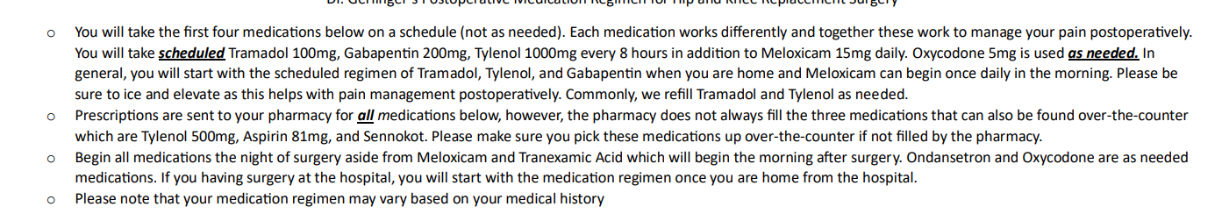
Medication Regimen cont'd
Notes:
Complete full course of blood thinner*

Slide 39
Post-op Physical Therapy
Outpatient Physical Therapy in the Home (OPITH)
  Midwest Ortho will send a therapist to your home after surgery
  2-3 x/week starting 7-10 days after your surgery
  You will be contacted one week prior to surgery by a coordinator. Your assigned therapist will call you 2 days prior to your first visit to discuss your specific schedule.
  Your therapist will transition you to an outpatient clinic by week 3. Dr Gerlinger recommends one of our Midwest Ortho PT locations (map on our website)
    If out of service area then you will begin outpatient PT 7 days after surgery
    Patients may opt out of home PT and can then start outpatient PT no sooner than 7 days post surgery
    Week 1: Focus on activities of daily living/getting around home safely, ice, rest, and elevate
  *PLEASE INCORPORATE REST BETWEEN PT SESSIONS. PT 2-3x PER WEEK WITH REST, ICE, ELEVATION, STRETCHING ON OFF DAYS*
Notes:
Some outpatient physical therapy locations offer transportation (look into ATI or Athletico).
Dr. Gerlinger feels strongly about doing your home exercises/stretches (taught by the therapist in the hospital post operative) for the first week after your surgery while getting a jump start on the healing process. Start outpatient physical therapy one week after your surgery.

Slide 40
MIDWEST ORTHOPAEDICS
OUTPATIENT PHYSICAL THERAPY LOCATIONS
You can call (312) 432-2591 to schedule at any of our PT locations. Alternatively, you can schedule at a facility of your choice if these locations are not convenient

Slide 41
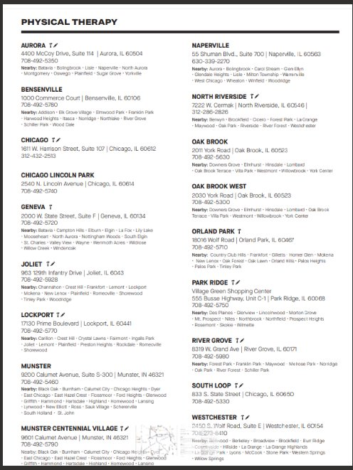

Slide 42
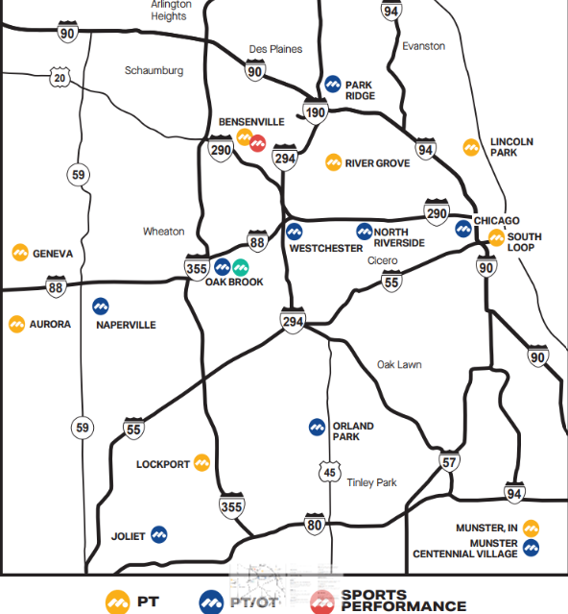

Slide 43
Follow Up Office Visits
Office Locations:
  Chicago, IL, Westchester, IL, Oak Brook, IL
~3-4 weeks postop
  Incision check
  X-rays for knee replacement, no Xrays for hip replacement
  Nylon sutures removed (if applicable)
~6 weeks postop
  X-rays for hip replacement patients
  Knee replacement patients may cancel 6-week visit by call office with update if doing well
Annual and as needed
Telemedicine visit available upon request
Notes:
Nylon sutures removed at 3wk postop f/u.
Six week minimum between surgeries.

Slide 44
Frequently Asked Questions
When can I return to work?
  Light duty/desk job: 2-4 weeks postop
  Heavy duty/physical job: 6-8 weeks postop
  Disability paperwork can be faxed to (708) 409-5179 attn: Dr. Gerlinger
When can I drive?
  Research shows that your brake reaction time has returned at 2-week mark, however, make sure you are off opioid medications and feel safe driving
When can I fly?
  Preferably after 3 week wound check appointment
  No implant cards anymore - opt to go through scanner at TSA
When can I return to activities/exercise?
  Typically by 6 weeks 75% recovered, 6 months 100%
  Ease into activity after 6 weeks allowing for rest as needed
When can I have my other knee/hip replaced?
  Generally speaking, 2-3 months between surgeries
  Varies patient to patient
Notes:
Work: If you provide our office with FMLA paperwork, we will write you off for 12 weeks and then write a return to work letter if ready to go back before then.
Drive: Dr. Gerlinger has done studies that show your brake reflex comes back about 2 weeks after your surgery. If you are 2 weeks post op and off the tramadol and oxycodone (your narcotics) and feel safe getting behind the wheel, you may do so. If you happened to get in an accident and the person you had an accident with finds out you are not 6 weeks post operative, they can take legal action.
Fly: You now have metal in your joint, you will set off alarms at TSA. TSA does not have cards anymore. All you have to do is let your TSA agent know you have a metal implant and opt to go through the scanner where you put you arms above your head. You should have no issues with setting off alarms using this method.
Exercise: We expect you to reach 75% healed at about 6 weeks and reach 100% at 6 months to a year. Returning to normal activity starts around the 6 week mark.
Other side surgery: You cannot get both knees/hips operated on the same time. 6 week minimum between surgeries.

Slide 45
Potential Risks and Complications
Infection
  Medically optimized by a RUSH medical provider
  CHG wash (wash surgical area night before and AM of surgery)
  Antibiotics given pre, during, and post surgery
  Short hospital stay
  Dental prophylaxis
    Lifelong recommendation for dental cleanings and procedures
      Amoxicillin 2000 mg 1 hour before OR
      Clindamycin 600 mg 1 hour before (if allergic to penicillin)
    No routine dental work 3wks prior to surgery and 3months after surgery – call office if urgent issue arises
Deep Vein Thrombosis / Pulmonary Embolism
  Anticoagulation medication (ex: Aspirin)
  Early mobilization
Hematoma
  Tranexamic medication given
  Drain with total knee replacement surgery helps prevent hematoma
  Incorporate rest post surgery
  Surgical compression dressing
Notes:
Wash your surgical site with hibiclens the night before your surgery and the morning of. There is a sheet in your surgical folder explaining in more depth.
Dentist prophylaxis: Our mouths are full of bacteria and when you go to the dentist, they poke around creating entryways for bacteria to enter the blood stream and they can colonize on new implants. Dr. Gerlinger has a lifelong recommendation of taking an oral antibiotic 1 hr before any dental cleaning, tooth extraction, cavity refill, etc. He also recommends NO elective dental work 3 weeks before your surgery and 3 months after your surgery to avoid infection.

Slide 46
Potential Risks and Complications (cont’d)
Loosening/failure of implant
Residual pain/stiffness
Fracture (allow for rest)
Nerve injury
  Elevated risk for peroneal nerve injury with preoperative valgus (knock knee) deformity
Blood loss
Skin tears, blisters, delayed wound healing/cellulitis
Leg length Discrepancy
Tendinitis present before surgery may or may not be present/worse following surgery. Further, you can still get tendinitis after joint replacement surgery (ex: IT band tendinitis, quadriceps tendinitis, patellar tendinitis)
Back pain present before surgery may or may not worsen following your knee or hip replacement surgery

Slide 47
Symptoms After Surgery
Common/Expected
When to Call
Swelling throughout leg
Bruising throughout leg
Warmth
Difficulty sleeping for first 4-6 weeks (may try Melatonin or Tylenol PM – recommend good sleep hygiene, ice, and avoiding activity before bed)
Clicking (may persist)
Intermittent low-grade temperatures (< 100 degrees) for first few days from surgery
Low energy for first few days
Calf pain, swelling, redness
Fevers greater than 101
Drainage from incision
Pain uncontrolled with medications
Inability bearing weight
Spreading redness
**Call 911 if you are experiencing chest pain and/or shortness of breath**

Slide 48
Remember to sign up for Dr. Gerlinger’s surgery texts
  Before surgery, text “JOIN” to 312-340-0700
  Follow prompts to enroll
    Standard messaging & data rates apply
    See Terms and Conditions: www.mystreamd.com/terms
Notes:
Green card in surgical folder. Reminders and encouraging tips in text form.

Slide 49
What do I do now?
How to prepare for your surgery
Attend preoperative medical appointment and specialist appointment(s) if necessary
Sign up for surgical texts
Purchase cold therapy/nutrition bundle if you'd like (entirely optional) and Gatorade for morning of surgery
Purchase CHG to use the night before surgery and morning of surgery
Outpatient surgery patients pick up post-op medications
Keep your phone handy for calls the week prior to surgery
Schedule outpatient PT visits to begin about 2 weeks after surgery when you finish home PT
  Schedule outpatient PT visits one week from surgery if going directly to outpatient PT
Stay well hydrated and eat nutritious meals
Call office if you have questions at (312) 432-2429
Relax and know you that you are in good hands!

Slide 50
Thank You!
Please call the office with any questions at (312) 432-2429

